Slide 1
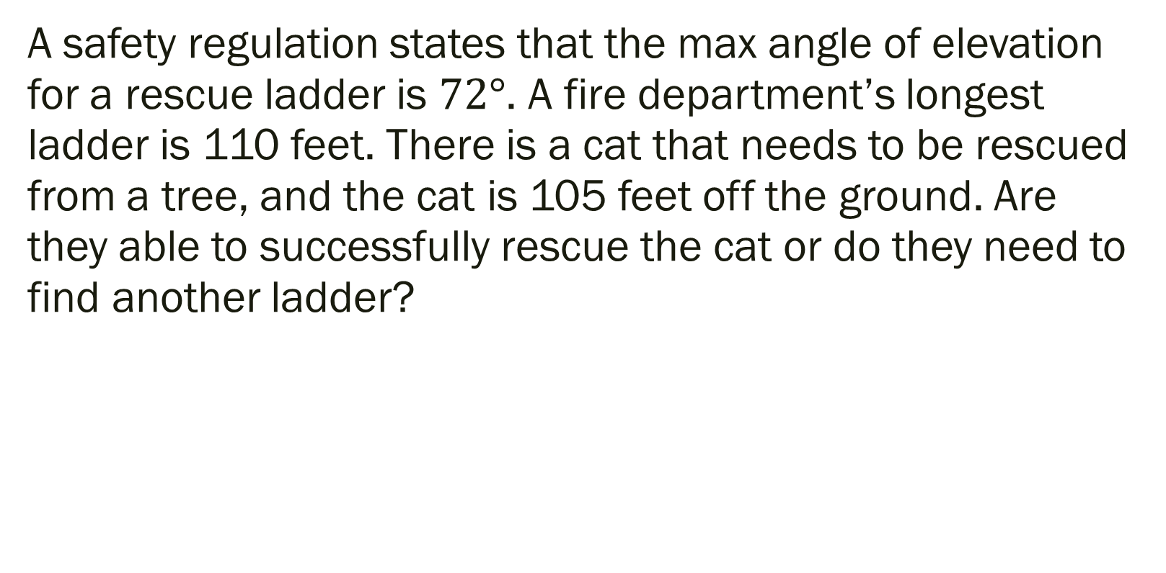
Bell Work: Additional Example
A safety regulation states that the max angle of elevation for a rescue ladder is $72°$. A fire department’s longest ladder is 110 feet. There is a cat that needs to be rescued from a tree, and the cat is 105 feet off the ground. Are they able to successfully rescue the cat or do they need to find another ladder?

Slide 2
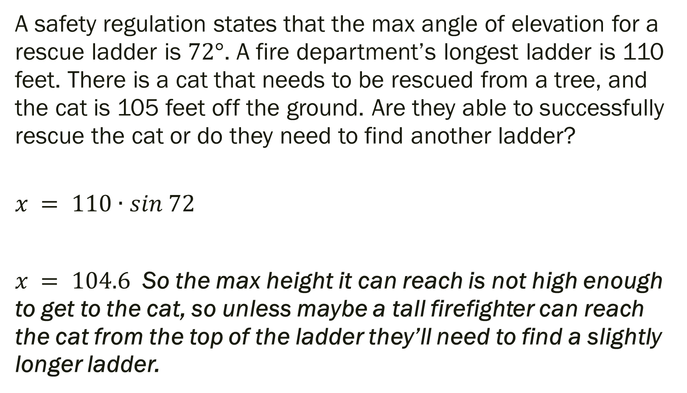
Bell Work: Solution
A safety regulation states that the max angle of elevation for a rescue ladder is $72°$. A fire department’s longest ladder is 110 feet. There is a cat that needs to be rescued from a tree, and the cat is 105 feet off the ground. Are they able to successfully rescue the cat or do they need to find another ladder?
$$x = 110∙sin 72$$
$x = 104.6$ So the max height it can reach is not high enough to get to the cat, so unless maybe a tall firefighter can reach the cat from the top of the ladder they’ll need to find a slightly longer ladder.

Slide 3
From Last Time…
Page 347 #1-4, 5-9 (odd), 23-27 (odd), 43, 49-51, 55, 105, 111
Get a Head Start…
Page 357 #5, 17, 19, 21, 24, 33,
51, 54-56, 62-63

Slide 4
Pre-calc trig
Day 37

Slide 5
4.8 Applications and Models
Objective: To Solve Real Life Problems Involving Right Triangles and Harmonic Motion

Slide 6


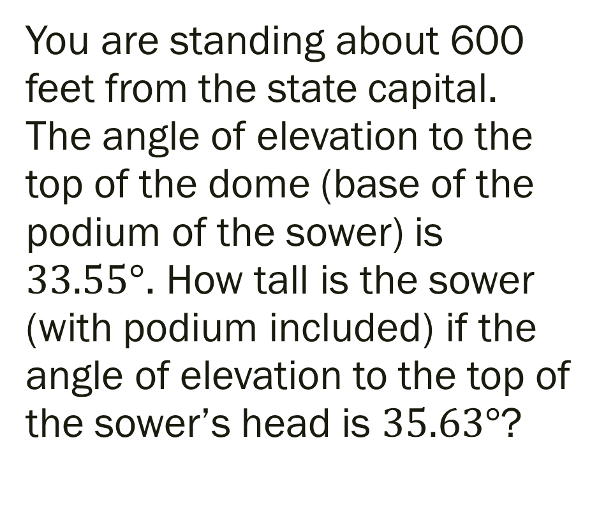
Example.
You are standing about 600 feet from the state capital. The angle of elevation to the top of the dome (base of the podium of the sower) is $33.55°$. How tall is the sower (with podium included) if the angle of elevation to the top of the sower’s head is $35.63°$?

Slide 7
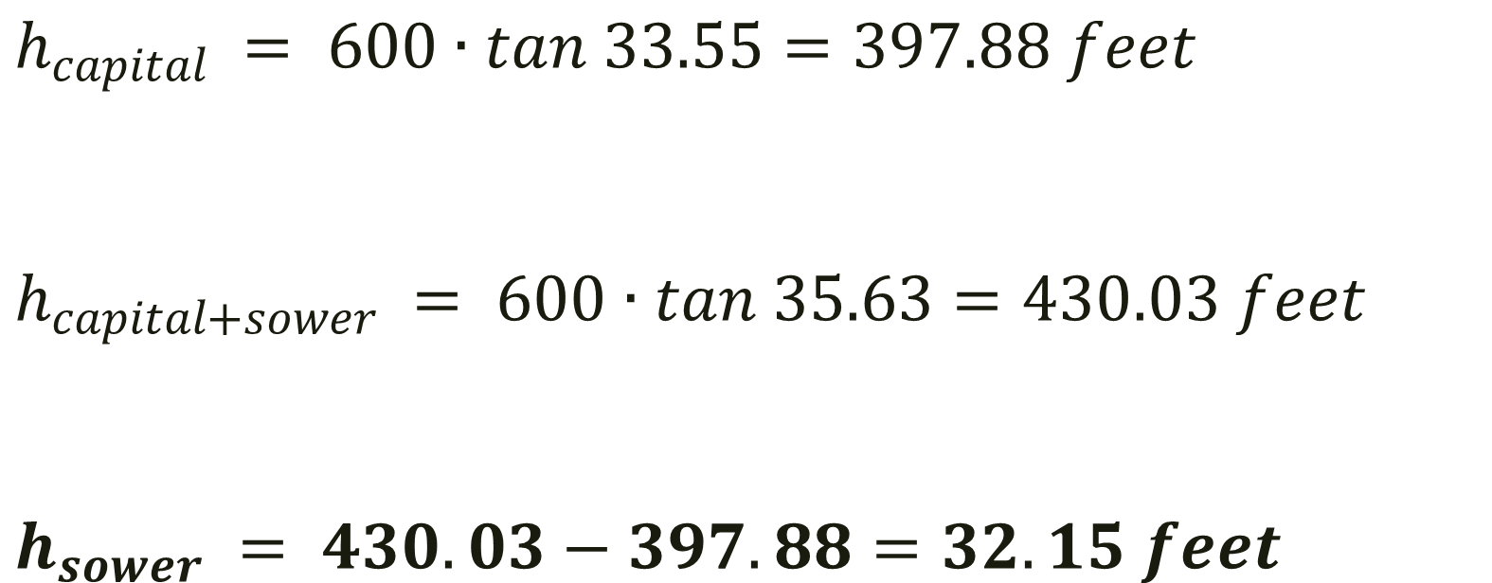
Solution
$$h_{capital} = 600∙tan 33.55=397.88 feet$$
$$h_{capital+sower} = 600∙tan 35.63=430.03 feet$$
$$h_{sower} = 430.03−397.88=32.15 feet$$

Slide 8
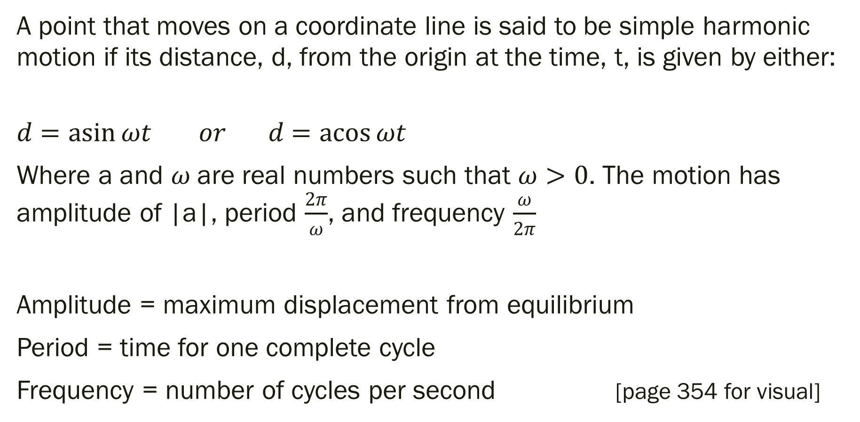
Definition of Simple Harmonic Motion
A point that moves on a coordinate line is said to be simple harmonic motion if its distance, d, from the origin at the time, t, is given by either:
$$d=\operatorname{asin}{ωt} or d=\operatorname{acos}{ωt}$$
Where a and $ω$ are real numbers such that $ω>0$. The motion has amplitude of |a|, period $\frac{2π}{ω}$, and frequency $\frac{ω}{2π}$
Amplitude = maximum displacement from equilibrium
Period = time for one complete cycle
Frequency = number of cycles per second [page 354 for visual]

Slide 9
Example
A ball is bouncing up and down on a spring. Suppose that 12 inches is the max distance the ball moves vertically (up or down) from its equilibrium (rest) position. Suppose the time it takes for the ball to move from its max displacement (above zero) to its min displacement (below zero) is 6 seconds.
Assuming perfect elasticity, no friction, and no air resistance, the ball would continue to move in a uniform motion. Find the amplitude, period, and frequency.

Slide 10
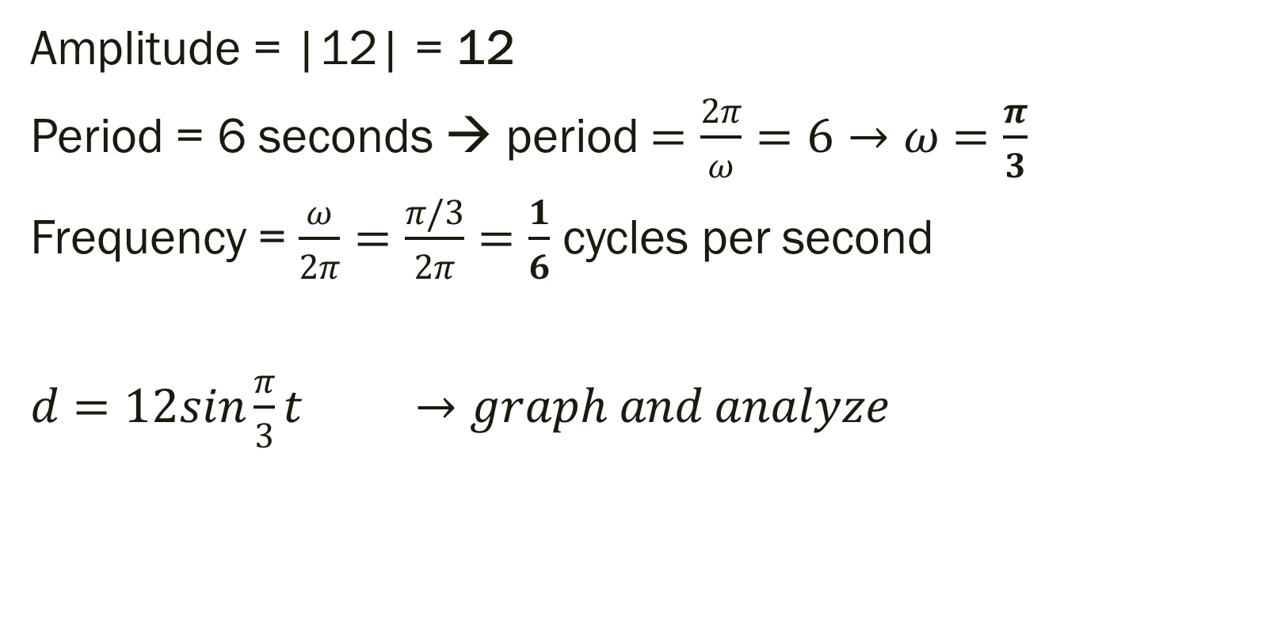
Solution
Amplitude = |12| = 12
Period = 6 seconds → period $=\frac{2π}{ω}=6→ω=\frac{π}{3}$
Frequency = $\frac{ω}{2π}=\frac{π/3}{2π}=\frac{1}{6}$ cycles per second
$d=12sin{\frac{π}{3}t} →graph and analyze$

Slide 11
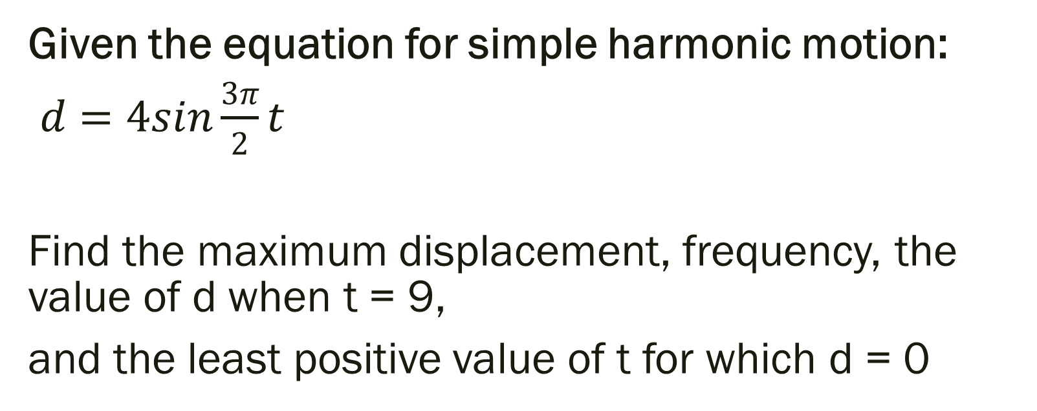
Example
Given the equation for simple harmonic motion:
$d=4sin{\frac{3π}{2}t}$
Find the maximum displacement, frequency, the value of d when t = 9,
and the least positive value of t for which d = 0

Slide 12
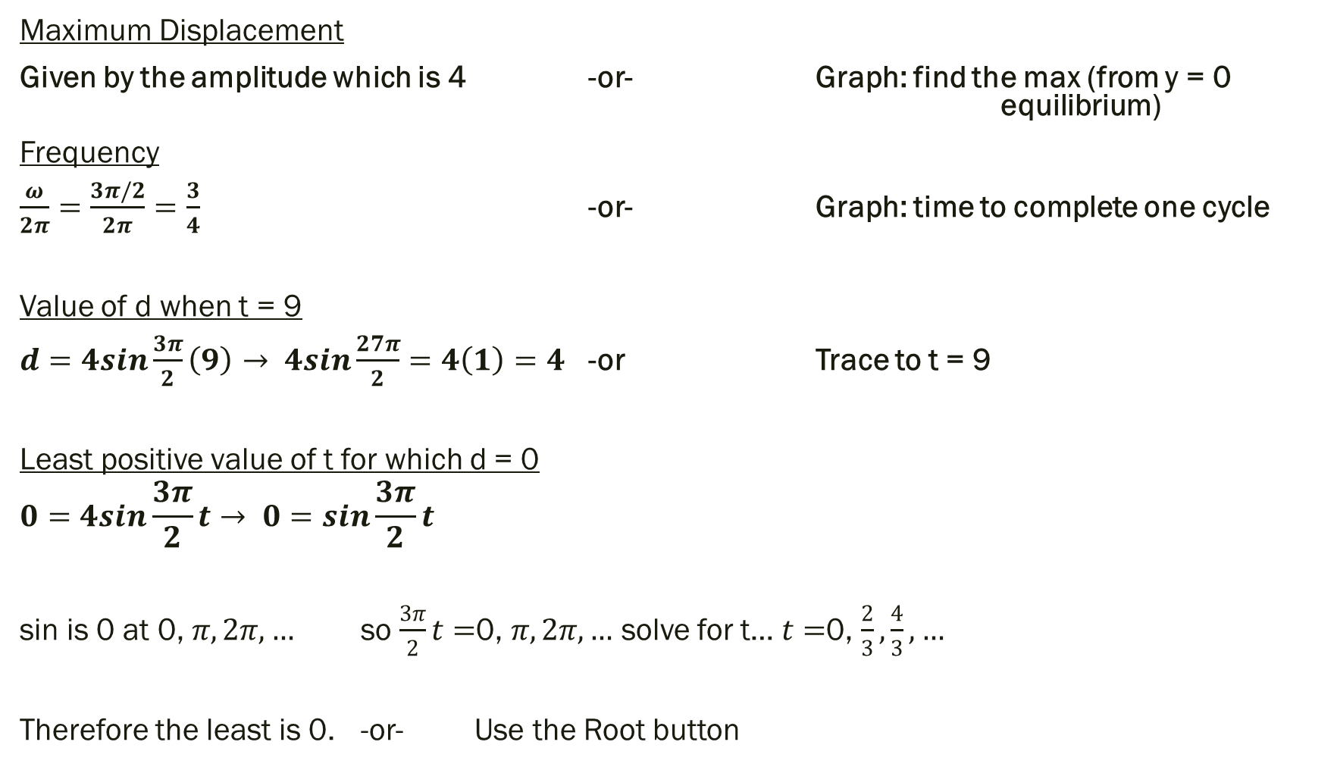
Solution
Maximum Displacement
Given by the amplitude which is 4 -or- Graph: find the max (from y = 0 equilibrium)
Frequency
$\frac{ω}{2π}=\frac{3π/2}{2π}=\frac{3}{4}$ -or- Graph: time to complete one cycle
Value of d when t = 9
$d=4sin{\frac{3π}{2}\left(9\right)→ 4sin{\frac{27π}{2}}}=4\left(1\right)=4$ -or Trace to t = 9
Least positive value of t for which d = 0
$$0=4sin{\frac{3π}{2}t}→ 0=\sin{\frac{3π}{2}t}$$
sin is 0 at 0, $π, 2π, …$ so $\frac{3π}{2}t=$0, $π, 2π, …$ solve for t… $t=$0, $\frac{2}{3}, \frac{4}{3}, …$
Therefore the least is 0. -or- Use the Root button

Slide 13
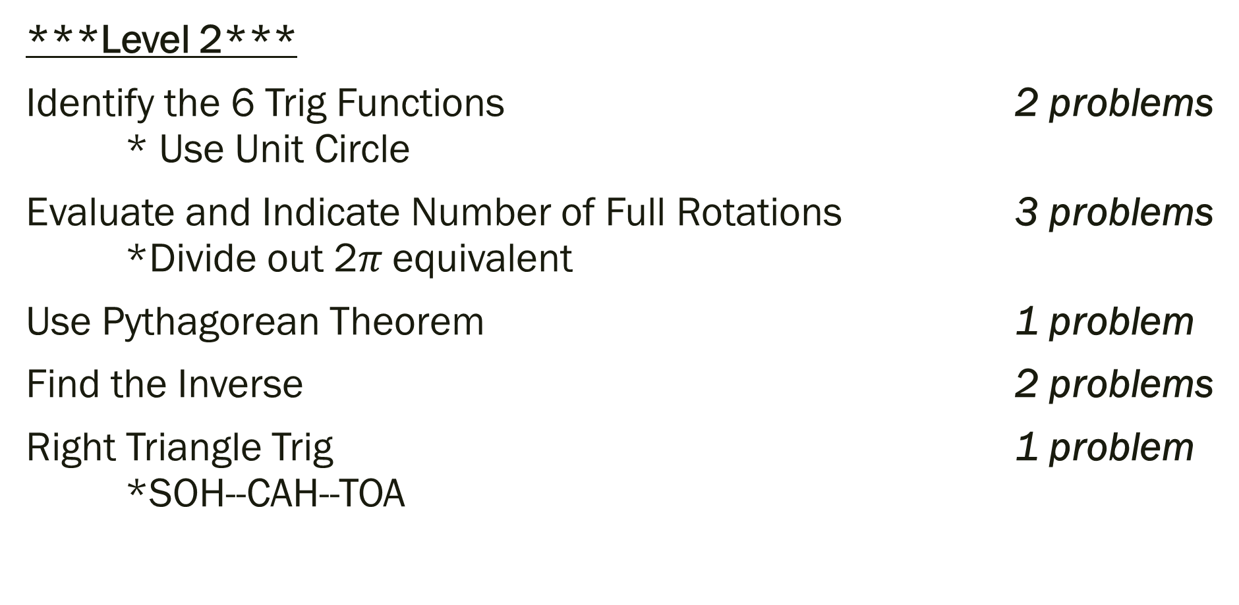
Things to Study for Test
***Level 2***
Identify the 6 Trig Functions 2 problems * Use Unit Circle
Evaluate and Indicate Number of Full Rotations 3 problems *Divide out 2$π$ equivalent
Use Pythagorean Theorem 1 problem
Find the Inverse 2 problems
Right Triangle Trig 1 problem *SOH--CAH--TOA

Slide 14
Things to Study for Test
***Level 3***
Given a trig function find the other trig functions 2 problems *Remember to Divide by the Radius (especially if a number other than 1)
Simple Harmonic Motion 1 problem *Max Displacement, Frequency, d when t = a #, least positive value of t
Use Trig Identities to Transform Equations 2 problems
***Level 4***
Apply Trig Properties to a Story Problem 2 problems

Slide 15
For Next Time
Page 357 #5, 17, 19, 21, 24, 33,
51, 54-56, 62-63
Review for Test
Page 364 #25–28, 41, 42, 57, 58, 62, 111–114, 131–134, 139–140
Page 367 #7, 8, 10, 11, 20

